Slide 1
Artificial Intelligence
Chapter 9
Heuristic Search

Slide 2
Outline
Using Evaluation Functions
A General Graph-Searching Algorithm
Algorithm A*
Iterative-Deepening A*
Heuristic Functions and Search Efficiency

Slide 3


9.1 Using Evaluation Functions
Best-first search (BFS) = Heuristic search
  proceeds preferentially using heuristics
  Basic idea
    Heuristic evaluation function : based on information specific to the problem domain
    Expand next that node, n, having the smallest value of
    Terminate when the node to be expanded next is a goal node
Eight-puzzle
  The number of tiles out of places: measure of the goodness of a state description

Slide 4
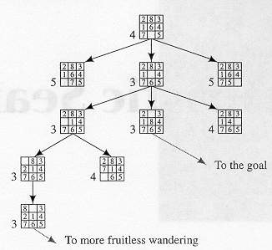
9.1 Using Evaluation Functions (cont’d)
Figure 9.1 A Possible Result of a Heuristic Search Procedure

Slide 5
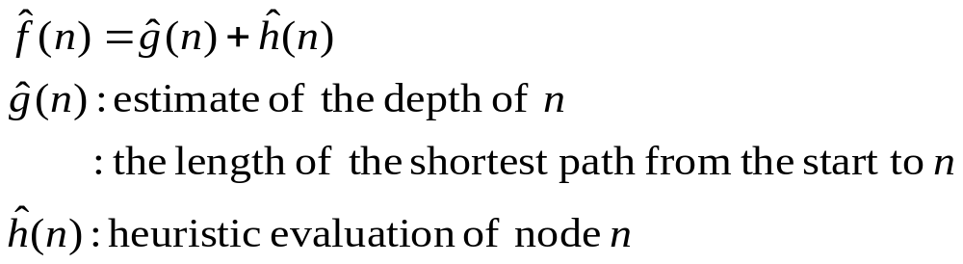
9.1 Using Evaluation Functions (cont’d)
  Preference to early path: add “depth factor” → Figure 9.2

Slide 6
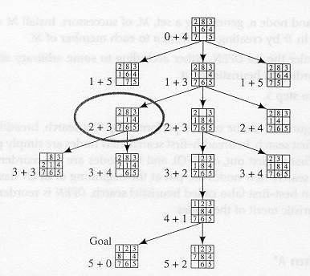

Slide 7
9.1 Using Evaluation Functions (cont’d)
Questions
  How to settle on evaluation functions for guiding BFS?
  What are some properties of BFS?
  Does BFS always result in finding good paths to a goal node?

Slide 8
9.2 A General Graph-Searching Algorithm
GRAPHSEARCH: general graph-searching algorithm
  Create a search tree, Tr, with the start node n₀ → put n₀ on ordered list OPEN
  Create empty list CLOSED
  If OPEN is empty, exit with failure
  Select the first node n on OPEN → remove it → put it on CLOSED
  If n is a goal node, exit successfully: obtain solution by tracing a path backward along the arcs from n to n₀ in Tr
  Expand n, generating a set M of successors + install M as successors of n by creating arcs from n to each member of M
  Reorder the list OPEN: by arbitrary scheme or heuristic merit
  Go to step 3

Slide 9
9.2 A General Graph-Searching Algorithm (cont’d)
Breadth-first search
  New nodes are put at the end of OPEN (FIFO)
  Nodes are not reordered
Depth-first search
  New nodes are put at the beginning of OPEN (LIFO)
Best-first (heuristic) search
  OPEN is reordered according to the heuristic merit of the nodes

Slide 10


9.2.1 Algorithm A*
Algorithm A*
  Reorders the nodes on OPEN according to increasing values of
Some additional notation
  h(n): the actual cost of the minimal cost path between n and a goal node
  g(n): the cost of a minimal cost path from n₀ to n
  f(n) = g(n) + h(n): the cost of a minimal cost path from n₀ to a goal node over all paths via node n
  f(n₀ ) = h(n₀ ): the cost of a minimal cost path from n₀ to a goal node
  : estimate of h(n)
  : the cost of the lowest-cost path found by A* so far to n

Slide 11

9.2.1 Algorithm A* (cont’d)
Algorithm A*
  If = 0: uniform-cost search
  When the graph being searched is not a tree?
    more than one sequence of actions that can lead to the same world state from the starting state
  In 8-puzzle problem
    Actions are reversible: implicit graph is not a tree
    Ignore loops in creating 8-puzzle search tree: don’t include the parent of a node among its successors
    Step 6
      Expand n, generating a set M of successors that are not already parents (ancestors) of n + install M as successors of n by creating arcs from n to each member of M

Slide 12
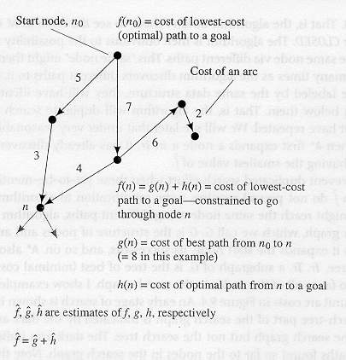
Figure 9.3 Heuristic Search Notation

Slide 13
9.2.1 Algorithm A* (cont’d)
Modification of A* to prevent duplicate search effort
  G
    search graph generated by A*
    structure of nodes and arcs generated by A*
  Tr
    subgraph of G
    tree of best (minimal cost) paths
  Keep the search graph
    subsequent search may find shorter paths
    the paths use some of the arcs in the earlier search graph, not in the earlier search tree

Slide 14
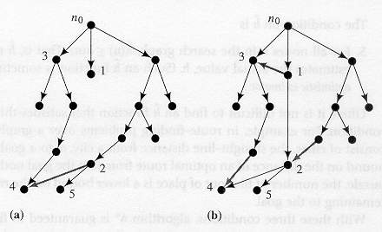
Figure 9.4 Search Graphs and Trees Produced by a Search Procedure

Slide 15
9.2.1 Algorithm A* (cont’d)
A* that maintains the search graph
  Create a search graph, G, consisting solely of the start node, n₀ → put n₀ on a list OPEN
  Create a list CLOSED: initially empty
  If OPEN is empty, exit with failure
  Select the first node on OPEN → remove it from OPEN → put it on CLOSED: node n
  If n is a goal node, exit successfully: obtain solution by tracing a path along the pointers from n to n₀ in G
  Expand node n, generating the set, M, of its successors that are not already ancestors of n in G →install these members of M as successors of n in G

Slide 16

9.2.1 Algorithm A* (cont’d)
  Establish a pointer to n from each of those members of M that were not already in G → add these members of M to OPEN
  → for each member, m, redirect its pointer to n if the best path to m found so far is through n → for each member of M already on CLOSED, redirect the pointers of each of its descendants in G
  Reorder the list OPEN in order of increasing values
  Go to step 3
  Redirecting pointers of descendants of nodes
    Save subsequent search effort

Slide 17


9.2.2 Admissibility of A*
Conditions that guarantee A* always finds minimal cost paths
  Each node in the graph has a finite number of successors
  All arcs in the graph have costs greater than some positive amount ε
  For all nodes in the search graph,
Theorem 9.1
  Under the conditions on graphs and on , and providing there is a path with finite cost from n₀ to a goal node, algorithm A* is guaranteed to terminate with a minimal-cost path to a goal

Slide 18

9.2.2 Admissibility of A* (cont’d)
Lemma 9.1
  At every step before termination of A*, there is always a node, n*, on OPEN with the following properties
    n* is on an optimal path to a goal
    A* has found an optimal path to n*
  Proof : by mathematical induction
    Base case
      at the beginning of search, n₀ is on OPEN and on an optimal path to the goal
      A* has found this path
      n₀ : n* of the lemma at this stage

Slide 19

9.2.2 Admissibility of A* (cont’d)
    Induction step
      assume the conclusions of the lemma at the time m nodes have been expanded ( )
      prove the conclusions true at the time m+1 nodes have been expanded
Continuing the proof of the theorem
  A* must terminate
  A* terminates in an optimal path
Admissible
  Algorithm that is guaranteed to find an optimal path to the goal
  With the 3 conditions of the theorem, A* is admissible
  Any function not overestimating h is admissible

Slide 20






9.2.2 Admissibility of A* (cont’d)
Theorem 9.2
  If is more informed than , then at the termination of their searches on any graph having a path from n₀ to a goal node, every node expanded by is also expanded by
  expands at least as many nodes as does
  is more efficient
Figure 9.6
  : uniform-cost search
  : breadth-first search
  uniform-cost/breadth-first search: admissible

Slide 21
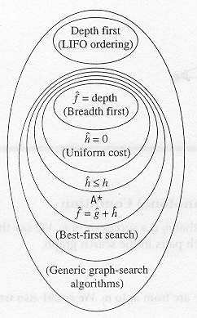
Figure 9.6 Relationships Among Search Algorithm

Slide 22




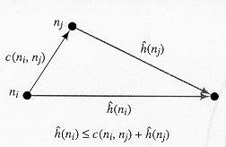
9.2.3 The Consistency (or Monotone) Condition
Consistency condition
  n_{j} is a successor of n_{i}
  : cost of the arc from n_{i} to n_{j}
  Rewriting
  A type of triangle inequality
Figure 9.7
The Consistency Condition

Slide 23
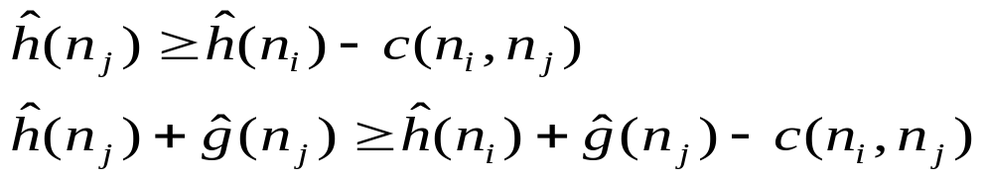


9.2.3 The Consistency (or Monotone) Condition (cont’d)
  Implies that values of the nodes are monotonically nondecreasing as we move away from the start node
  Consistency condition on is often called the monotone condition on
  Theorem 9.3
    If the consistency condition on is satisfied, then when A* expands a node n, it has already found an optimal path to n

Slide 24



9.2.3 The Consistency (or Monotone) Condition (cont’d)
Argument for the admissibility of A* under the consistency condition
  Monotonicity of : search expands outward along contours of increasing values
  The first goal node selected will be a goal node having a minimal
  For any goal node, n_{g},
  The first goal node selected will be one having minimal
  Whenever a goal node, n_{g}, is selected for expansion, we have found an optimal path to that goal node ( )
  The first goal node selected will be one for which the algorithm has found an optimal path

Slide 25

9.2.4 Iterative-Deepening A*
Breadth-first search
  Exponentially growing memory requirements
Iterative deepening search
  Memory grows linearly with the depth of the goal
  Parallel implementation of IDA*: further efficiencies gain
IDA*
  Cost cut off in the first search:
  Depth-first search with backtracking
  If the search terminates at a goal node: minimal-cost path
  Otherwise
    increase the cut-off value and start another search
    The lowest values of the nodes visited (not expanded) in the previous search is used as the new cut-off value in the next search

Slide 26


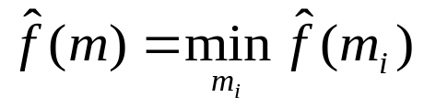
9.2.5 Recursive Best-First Search
RBFS (recursive best-first search)
  uses slightly more memory than does IDA*
  generates fewer nodes than does IDA*
Backing up value
  When a node n is expanded, computes values of successors of n and recomputes values of n and all of n’s ancestors
Process of backing up
  Backed-up value, , of node m with successors

Slide 27
9.2.5 Recursive Best-First Search (cont’d)
Description
  One of successors of node n has the smallest over all OPEN nodes, it is expanded in turn, and so on.
  When other OPEN node, n’, (not a successor of n) has the lowest value of
    backtracks to the lowest common ancestor, node k
    k_{n}: successor of node k on the path to n
    RBFS removes the subtree rooted at k_{n}, from OPEN
    k_{n} becomes an OPEN node with value (its backed-up value)
    Search continues below that OPEN node with the lowest value of

Slide 28
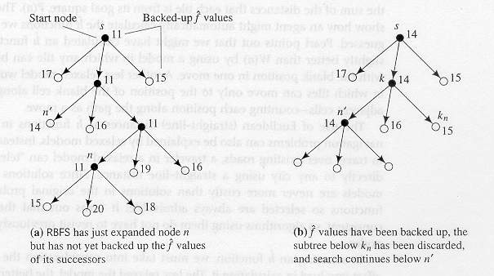
Figure 9.9 Recursive Best-First Search

Slide 29

9.3 Heuristic Functions and Search Efficiency
Selection of heuristic function
  Crucial for the efficiency of A*
    assures admissibility
    Uniform-cost search → inefficient
  = the highest possible lower bound on h
    maintains admissibility
    expands the fewest nodes
Using relaxed model
  functions are always admissible

Slide 30
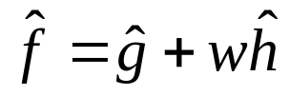
9.3 Heuristic Functions and Search Efficiency (cont’d)
Selecting function
  must consider the amount of effort involved in calculating it
  Less relaxed model: better heuristic function (difficult in calculating)
  Trade off between the benefits gained by an accurate and the cost of computing it
Using instead of the lower bound of h
  increases efficiency at the expense of admissibility
  : easier to compute
Modifying the relative weights of and in the evaluation function
  Large values of w: overemphasize the heuristic component
  Very small values of w: give the search a predominantly breadth-first character

Slide 31
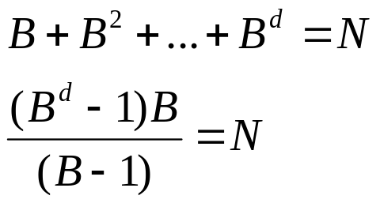
9.3 Heuristic Functions and Search Efficiency (cont’d)
Simultaneous searches from both the start and a goal node
  Breadth-first search
    search frontiers meet between start and goal
    guaranteed to find an optimal path
  Heuristic search
    Two search frontiers might not meet to produce an optimal path
Effective branching factor
  describes how sharply a search process is focused toward a goal
  B = the number of successors of each node in the tree having the following properties
    Nonleaf node has the same number (B) of successors
    Leaf nodes are all of depth d
    Total number of nodes is N

Slide 32
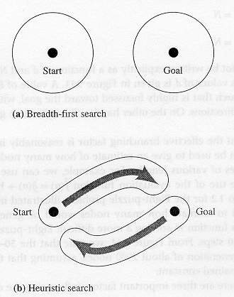
Figure 9.10 Bidirectional Searches

Slide 33
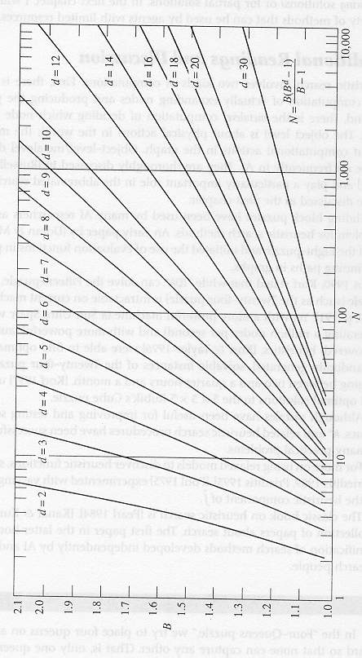
Figure 9.11 B Versus N for Various Values of d

Slide 34
9.3 Heuristic Functions and Search Efficiency (cont’d)
3 important factors influencing the efficiency of algorithm A*
  The cost (or length) of the path found
  The number of nodes expanded in finding the path
  The computational effort required to compute
Time complexity: O(n)
  Breadth-first search: O(B^{d})
  Uniform-cost search ( ): O(B^{C/c})
    C: cost of an optimal solution
    c: cost of the least costly arc

Slide 35
9.4 Additional Readings and Discussion

